Slide 1
ENTERTAINER DATA ANALYTICS DASHBOARD
By Shashank Shekhar

Slide 2


PROJECT OVERVIEW
Introduction
This project focuses on analyzing data related to entertainers in the film and entertainment industry. The goal is to gain insights into their careers, achievements, and demographics.
Dataset
The dataset includes information on entertainers' basic details, breakthrough events, major awards, last major work, and more.

Slide 3
DATA PREPARATION
Cleaning Process:
The dataset underwent cleaning to handle missing values and inconsistencies. Techniques such as mean imputation and filling with 'Unknown' were used.
Merging Data:
Data from different sources (Basic Info, Breakthrough Info, Last Work Info) were merged based on the entertainer's name.
Key Fields:
The key fields used in the analysis include Birth Year, Breakthrough Year, Award Year, Last Major Work Year, and Gender.

Slide 4
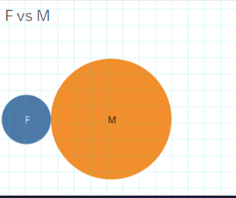
BASIC INFORMATION ANALYSIS
Gender Distribution
The gender distribution among entertainers shows a higher representation of female entertainers.
Age Distribution
The age distribution at the time of breakthrough and major awards shows most entertainers are in their 20s and 30s.

Slide 5
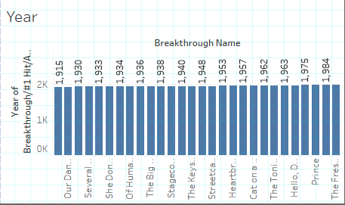
BREAKTHROUGH ANALYSIS
Breakthrough Year Distribution
Analyzing the years when entertainers had their breakthrough events shows significant activity in the late 20th century.
Trends
There are noticeable trends in the timing of breakthrough events, with peaks in specific decades reflecting changes in the industry.

Slide 6
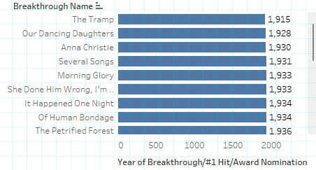
AWARD ANALYSIS
First Major Award Year
The distribution of years when entertainers received their first major awards shows clustering within a few years of their breakthrough.
Correlation
There is a strong correlation between the breakthrough year and the first major award year, indicating early recognition of talent.

Slide 7
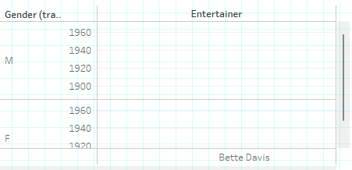
LAST MAJOR WORK ANALYSIS
Last Major Work Year:
The distribution of the last major work year shows that many entertainers have continued to contribute significantly even in recent years.
Career Longevity
Insights into the longevity of entertainers' careers indicate that many have sustained long and active careers.

Slide 8
CONCLUSION
Summary:
The analysis provides valuable insights into the career trajectories and achievements of entertainers.
Key Takeaways:
"Trends in breakthrough and award timings."
"Gender and age distribution patterns."
"Longevity of careers in the entertainment industry."
Future Work
Potential areas for further analysis include deeper demographic studies and impact analysis of major works.

Slide 9
